Slide 2
Event-Driven Architecture Overview
Service-Oriented Architecture and Event- Driven Architecture
SOA’s interaction with event-driven architecture (EDA). Defined with two distinct interactions.
In the first interaction, the occurrence of an event (a notable thing that happens inside or outside your business) can trigger the invocation of one or many services. Those services may perform simple functions, or entire business processes. This interaction between events and services is commonly referred to as event-driven SOA.

Slide 3
Service orientation is an architectural concept that refers to the loose coupling of a service (an abstract resource with a defined job) and its provider (the physical asset(s) that perform the job tasks).
A requestor only knows what the service’s job is and how to request it. The service is the only one that knows its implementation.
SOA is an IT architecture strategy for business solution (and infrastructure solution) delivery based on the concept of service orientation.
The two primary styles of SOA used in business solution development are composite application development and flow.
In composite applications, the user interaction drives a request for one or many services. Most of the service invocations are synchronous in nature.
A composite application typically serves one business domain. Composite applications are often delivered in a portal.

Slide 4
In the second interaction, a service may generate an event. The event may signify a problem or impending problem, an opportunity, a threshold, or a deviation.
Upon generation, the event is immediately disseminated to all interested parties (human or automated).
The interested parties evaluate the event, and optionally take action.
The event-driven action may include the invocation of a service, the triggering of a business process, and/or further information publication/syndication.
In this interaction, the service is purely one of many event sources in a broader event-driven architecture.

Slide 5
EVENT-DRIVEN ARCHITECTURE BASICS
Event Basics
WHAT IS AN EVENT? An event is a notable thing that happens inside or outside your business. An event (business or system) may signify a problem or impending problem, an opportunity, a threshold, or a deviation.
Specification and Occurrence. The term event is often used interchangeably to refer to both the specification (definition) of the event, and each individual occurrence (instance) of the event.
Define in Business Terms. For an event to be meaningful to downstream subscribers (human and automated) it is imperative that the event (name and body) is specified in business terms, not data or application terms.

Slide 6
WHAT IS IN AN EVENT? Each event occurrence has an event header and event body.
The event header contains elements describing the event occurrence, such as the event specification ID, event type, event name, event timestamp, event occurrence number, and event creator.
These elements are consistent, across event specifications.
Event Body. The event body describes what happened.
For example, if a retailer specified a low inventory threshold event, the event body would contain the information to communicate which product fell below the allowable threshold.
The event body must be fully described so any interested party can use the information without having to go back to the source system.
For the low inventory threshold event, the event body would contain not only the product identifier, but also the product description, and the point in time inventory and threshold levels.
To ensure events are understood by all consumers, a clear business lexicon or ontology should be used

Slide 7
WHAT IS AN EVENT-DRIVEN ARCHITECTURE?
In an event-driven architecture, a notable thing happens WHAT IS AN EVENT-DRIVEN ARCHITECTURE?
In an event-driven architecture, a notable thing happens happens inside or outside your business, which disseminates immediately to all interested parties (human or automated).
The interested parties evaluate the event, and optionally take action. The event-driven action may include the invocation of a service, the triggering of a business process, and/or further information publication/syndication.
Extreme Loose Coupling. By its nature, an event driven architecture is extremely loosely coupled, and highly distributed. The creator (source) of the event only knows the event transpired. The creator has no knowledge of the event’s subsequent processing, or the interested parties. The traceability of an event through a dynamic multipath event network can be difficult. Thus, event-driven architectures are best used for asynchronous flows of work and information.

Slide 8
Event Processing Styles
There are three general styles of event processing: simple, stream, and complex. The three styles are often used together in a mature event-driven architecture.
SIMPLE EVENT PROCESSING. In simple event processing, a notable event happens, initiating downstream action(s). Simple event processing is commonly used to drive the real-time flow of work—taking lag time and cost out of a business.
STREAM EVENT PROCESSING. In stream event processing, both ordinary and notable events happen. Ordinary events (orders, RFID transmissions) are both screened for notability and streamed to information subscribers. Stream event processing is commonly used to drive the real-time flow of information in and around the enterprise enabling intime decision making.

Slide 9
COMPLEX EVENT PROCESSING. Complex event processing (CEP) deals with evaluating a confluence of events and then taking action. The events (notable or ordinary) may cross event types and occur over a long period of time. The event correlation may be casual, temporal, or spatial. CEP requires the employment of sophisticated event interpreters, event pattern definition and matching, and correlation techniques. CEP is commonly used to detect and respond to business anomalies, threats, and opportunities.

Slide 10
EVENT PROCESSING
In this section, we present example event flows for each style of event processing. The flows are represented logically, broken out into four layers. Before jumping into the event flows, we describe the logical layers.
Event Flow Layers
An event flow starts with the event being generated and culminates with the execution of any downstream (event-driven) activity. The four logical layers are as follows:

Slide 11
EVENT GENERATORS. Every event is generated from a source. The source might be an application, data store, service, business process, transmitter, sensor, or collaboration tool (IM, email). An ordinary event may be evaluated for notability by an event preprocessor (router, filter), resulting in the generation of a new notable event. Because of the variety of event generators, not all events will be generated in the required format for event processing. In those cases, the events need to be transformed to the required (enterprise standard) format prior to being deposited in the event channel. generation of a new notable event.
Because of the variety of event generators, not all events will be generated in the required format for event processing. In those cases, the events need to be transformed to the required (enterprise standard) format prior to being deposited in the event channel

Slide 12
EVENT CHANNEL. The event channel, typically a messaging backbone, transports standard formatted events between event generators, event processing engines, and downstream subscribers.
EVENT PROCESSING. In the event processing layer, upon receipt, events are evaluated against event processing rules, and actions are initiated. The event processing rules and actions are defined in accordance to the needs of the interested parties, not of the event generators.
The actions include invoking a service, initiating a business process, publishing the event out to a subscription hub, directly notifying humans or systems, generating a new event, and/or capturing the event for historical purposes.
Events are processed by engines. A simple engine processes each event occurrence independently. A complex engine processes new event occurrences in context of prior and future events.

Slide 13
DOWNSTREAM EVENT-DRIVEN ACTIVITY. A
single event, or event correlation, may initiate numerous downstream activities. The invocation of the activity might be a push by the event processing engine (service invocation, business process initiation, notification) or a pull by subscribers of event publications. Subscribers might be humans, applications, active business processes, data warehouses, performance dashboards, and/or automated agents.
Events should be published in the standard event format. Transformation to subscriber-specific formats is typically done by an enterprise integration backbone.

Slide 14
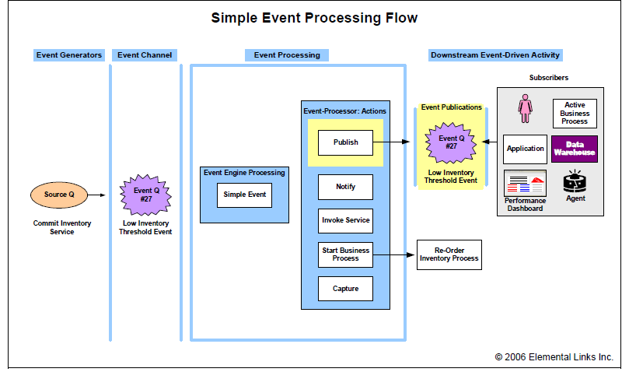
SIMPLE EVENT PROCESSING. In Illustration 1, we show a simple event processing flow for an online bookseller’s inventory position optimization. When a customer places an order for books, the

Slide 15
The Low Inventory Threshold event is deposited into the event channel and received by the simple event processing engine. The processing rules for this event type (Low Inventory Threshold) dictate two actions. A re-order inventory process is initiated, and the event is published for subscription. The subscribers are the inventory buyer, and the inventory manager’s performance dashboard. The re-order inventory process could be a straight-through process, or it could require human review and approval
STREAM EVENT PROCESSING. In Illustration 2, we show three stream event processing flows for a multichannel consumer electronics retailer. In the first flow, top left hand corner of Illustration 2, an RFID sensor is emitting events every time a product leaves the warehouse. The consumer electronics retailer wants to be informed when high-end products leave the warehouse. To meet this requirement, a local event filter has rules to filter out events for items priced less than $4,000. One event, Event A, occurrence 2, is for a $5,000 plasma TV. This event is reformatted to a standard event format, and placed in the event channel.5 The simple event processing engine receives the event, and following the rules for high-end products leaving the warehouse, publishes the event. The event is subscribed to by the inventory manager’s performance dashboard.

Slide 16
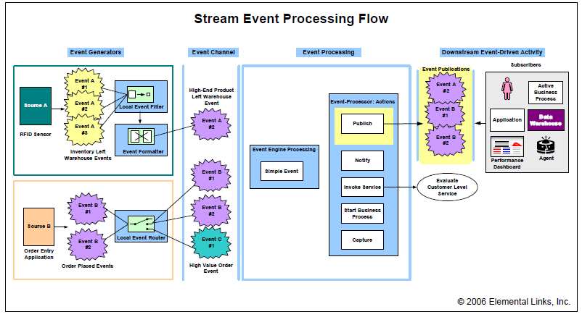
It is an architectural decision if the local event filter should be aware of the proprietary RFID format, or if all RFID events should be transformed to a standard format (event formatter), and then evaluated by a local event filter.

Slide 17
COMPLEX EVENT PROCESSING. In Illustration 3, we show three complex event processing flows for the same multichannel consumer electronics retailer. In the first flow, top left hand corner of Illustration 3, a business-to-business order gateway is supposed to be emitting System Heartbeat events every 15 minutes.
The System Heartbeat events inform IT operations the gateway is up and running. The absence of a heartbeat event indicates a failure. If the order gateway is down, business customers are likely to place an order with a competitor. The complex event engine tracks the timestamp of the last received System Heartbeat event. If 15 minutes have elapsed, the event processing actions associated with non-arrival are initiated.

Slide 18
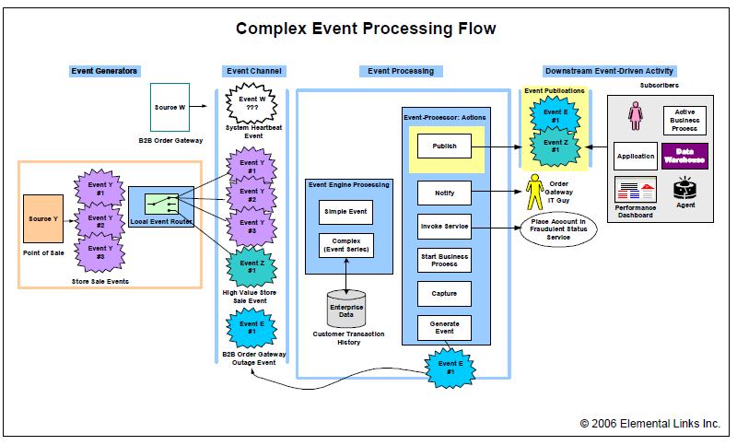

Slide 19
In this case, the order gateway IT guy is immediately notified (paged) and a new B2B Order Gateway Failure event is generated.
This new B2B Order Gateway event is deposited into the event channel. When the B2B Order Gateway Failure event is received by the simple event engine, a publishing action is performed.
The enterprise problem management system subscribes to this event for resolution tracking. The second and third flows show two variations of fraud detection. Both flows originate with the point-of-sale application shown at the bottom left hand corner of Illustration 3.
Similar to the customer order example above, for every store sale, an ordinary Store Sale event is generated (Event Y, occurrences 1-3).
These events are evaluated by a local event router, producing High Value Store Sale events (Event Z, occurrence 1) for transactions more than $1,500. All of the Store Sale events, ordinary and notable (high value), are deposited in the event channel.

Slide 20
In the first fraud detection flow, the complex event engine checks for multiple transactions (ordinary store sale events) by the same customer (credit card), over a short amount of time (10 minutes), at different locations over a large distance (20 miles).
If these conditions are met, the place account in fraudulent status service is invoked.
In the second fraud detection flow, on receipt of a High Value Store Sale event, the complex event engine does an inquiry on the customer’s past purchases to determine if this purchase should be marked suspicious.6 If the current purchase amount deviates more than 50 percent from largest historical purchase, the event (Z, occurrence 1) is published as suspicious. A customer advocate team subscribes to

Slide 21
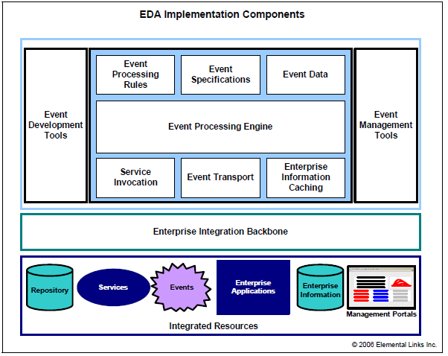

Slide 22
EVENT-DRIVEN ARCHITECTURE: A WORKING DEFINITION
An event-driven architecture is one that has the ability to detect events and react intelligently to them.
Brenda Michelson, a technology analyst, writes, “In an event-driven architecture, a notable thing happens inside or outside your business, which disseminates immediately to all interested parties (human or automated).
The interested parties evaluate the event, and optionally take action.”
One of the simplest examples of an event-driven system is actually from the noncomputer world.
It is known as a thermostat.
The thermostat is a mechanical device that turns the heat on or off based on its programmed reaction to an event, which is a change in temperature.
The shift in temperature is the event, the “change in state” that triggers the reaction of the thermostat, which, in turn, affects the action of the heater.

Slide 23
One commonly used technology that is analogous to EDA is the Web itself. When you use a browser, you are initiating an integrated session with a remote system of which you have no specific knowledge.
In all probability, you have no idea who programmed it, what language it’s written in, where it is, and so on.
Yet, your browser can pull whatever information it is permitted to get and show it to you in a format that you can understand.
The event of requesting the uniform resource locator (URL) triggers the action that results in the display of the Hypertext Markup Language (HTML) content in your browser window.
An EDA consists of applications that are programmed to publish, subscribe, or take other actions upon events triggered by applications with which they share no formal coupling.

Slide 24
Example :
If your cat steps on your toe, how do you know it? How do you know it’s a cat, and not a lion? You might want to pet the cat, but shoot the lion. When the cat’s paw presses against your toe, the nerve cells in your toe fire off a signal to your brain saying, “Hey, someone stepped on my toe.” Also, they send a message that says something like, “It doesn’t hurt that much” and “It was probably a cat.” Or, if you saw the cat, the signals from your optic nerve are synthesized with those from your toe, each invoking your mental data store of animals and likely toe steppers, and you should know pretty quickly that it was, indeed, a cat that stepped on your toe.
Your central nervous system is a massively complex set of sensory receptors, wires, and integration points, known as synapses.
The nervous system is critical to your functioning and survival in the world. Just imagine if your central nervous system didn’t work well and you confused the cat with the lion.
As Figure I.1 shows, you might shoot your cat and pet the lion, which would then eat you.

Slide 26
Our enterprises have their own nervous systems, too.
Our Web sites, enterprise resource planning (ERP) systems, customer relationship management (CRM) systems, databases, and network infrastructures, for example, all work to feed the corporate equivalent of sensory information to the corporate “brain.”
The corporate brain, in turn, assesses the input and reacts.
Of course, the corporate brain might contain a few actual brains as well, in the form of employees, but their sensory input is determined by the enterprise nervous system.
For example, if there is an increase in cash withdrawals at a bank, the banking systems, acting like nerve sensors in our toe, fire off withdrawal data to the corporate brain..
The neurons in the corporate brain then route the data to its destination, which could be an automated bank cash reserve management system, the executive management team of the bank, or a combination.
As our brain assesses and reacts to the cat stepping on our toe, the corporate brain of the bank must assess the input of the withdrawal spike and react.
Building an EDA to instill good functioning to the enterprise nervous system involves getting the various sensors, message pathways, and reacting logic processors to work together. In broad terms, this is known as interoperation, and it is the heart of the new EDA discussion going on today.

Slide 27
THE “NEW” ERA OF INTEROPERABILITY DAWNS
Reading about EDA as a “new” idea might give you a sense of déjà vu.
However, the current crop of EDAs uses proprietary standards for communication, and although they work well, they are, in effect, tightly coupled EDAs that can only share information among systems that use a compatible standard.
For instance, it is possible to set up a fairly effective EDA if all systems are built on the same platform.
Vendors have long provided high-performance pub/sub engines for compatible systems.
The good news is that many platform vendors have released new service-based EDA products, which do not rely on tight coupling.

Slide 28
The quest for a well-functioning enterprise nervous system has been the catalyst for the development of EDA for many years.
Why, then, is EDA receiving such renewed and intense interest today?
The reason has to do with the explosion in interoperability and the standardization of data across multiple enterprises, which changes the game of EDA.
Ultimately, the existence of an EDA is dependent on interoperability among systems.
You can’t have awareness and reaction to events if the systems cannot communicate with one another.
Existing EDA setups are invariably tightly constrained and narrow in their functionality because it has been so difficult, or costly, to achieve the level of interoperation of EDA components needed for any kind of dynamic or complex EDA functionality.
That is now changing.
Today, with the advent of open standards and the breakthroughs in system interoperability from service-oriented architectures (SOAs), it is now possible to establish EDAs that are far more intelligent, dynamic, and far-reaching than ever before.

Slide 29
Many enterprises have begun to introduce service-orientation in their architectures, selectively exposing capabilities through Web services in configurations that suit specific business needs and selectively service enabling core legacy systems.
SOA is very much the technological trend of the moment, and it is everywhere.
You see SOA as a prominent feature set in products from Microsoft, Oracle, IBM, SAP, and so on.
Virtually every major technology company has announced an SOA strategy or even shifted their entire market focus to being service-oriented.
A sure sign that SOA had reached prime time was when Accenture announced that it was going to spend $450 million on an SOA consulting initiative for its global clients.

Slide 30
SOA removes much, if not all, of the proprietary middleware and network compatibility blockages that inhibit rapid changes in application integration.
As a result, they can loosen the coupling between applications.
Given how important agility is, tight coupling is rightly held out as the enemy of agility.
Loose coupling is the enabler of agility and SOA delivers loose coupling.
Changes become simpler, faster, and cheaper.
As integration agility becomes reality, so does EDA and its increased awareness.
Therefore, SOA delivers the necessary agility required for an EDA.
However, achieving this goal of EDA through loose coupling without destroying a range of security, governance, and performance standards requires a great deal of planning and work.
And, as we start to see, the path from where we are now, to SOA and then EDA, is not always clear.

Slide 31
EDA: Opportunities and Obstacles
Event-driven architecture (EDA)—and by this, we mean the modern, dynamic, and agile kind—presents a superb solution to a range of major organizational IT challenges.
Yet, despite its desirability, its attainment has been frustratingly out of reach for many years.
This has changed, though, with the advent of service-oriented architecture (SOA).

Slide 32
EDA: A WORKING SYSTEMIC DEFINITION
Defining an Event
First, let’s define what we mean by an event.
In life, an event is something that happens: a car drives by, a ball flies through your window, someone falls asleep—an action occurs.
Alternatively, for our purposes, an event can also be an expected action that does not occur.
If the temperature does not go down at night, that could be an event.
In systemic terms, an event generally refers to a change in state.
A change in state typically means that a data value has changed.
For example, if you exceed your allowance of minutes of cellular phone time, your wireless carrier bills you for the overage.
In EDA terms, the state of your minutes goes from “Under” to “Over,” and that change in state triggers the billing of the overage charge.
The value of your account balance changes as you exceed the minute allowance.
The shift from minutes = under to minutes = over is an event.

Slide 33
An event has three levels of detail.
At one level, there is the basic fact that an event has occurred.
An event has either occurred or not.
This takes us to the second level of detail, which is the event definition.
To recognize an event, an EDA must have a definition of what the event is.
In the cell phone example, the EDA must work with a definition of an event that says, in effect, a “change in minutes” event has occurred whenever the allowance limit is exceeded.
Then, there is the detail of the specific event.
By how much has the minute allowance been exceeded? In our example, the three levels of event detail would look like this:
(1) An event has occurred, based on the following definition,
(2) an event is defined as “minutes=over,” and
(3) the event detail says “So-and-so’s minutes have been exceeded. Amount =10 minutes.” All three factors—event notification, event definition, and event detail—are necessary when designing an EDA.

Slide 34
Armed with a sense of what an event can be, we can now add some flesh to the basic EDA definition.
If an event is any “notable thing” that happens inside or outside our businesses, then an EDA is the complete array of architectural elements, including design, planning, technology, organization, and so on, which enables the ability to disseminate the event immediately to all interested parties, human or automated.
The EDA also provides the basis for interested parties to “evaluate the event, and optionally take action.”
The reason that EDA is a challenging concept is that it is so potentially broad.
Just as almost any piece of data, analog or digital, can be an event, and any system in the universe can potentially be part of your EDA, where do you begin to draw the boundaries and definition of an EDA that makes sense to your organization?
Though there is no bullet-proof way to answer the question, we think that it makes sense to identify the main ingredients of an EDA, and build the definition from these constructs.

Slide 35
Event Producers or Publishers
To have an EDA, you must first have events. That might seem obvious, but a lot of otherwise sophisticated discussions of EDA either neglect or muddle up this central enabling concept. The EDA cannot work unless it has the ability to perceive that an event has occurred. For that to happen, the event must be created and then disseminated for consumption to EDA components called listeners (see next section) to “hear” them.
The technologies that do this are known as event publishers or event producers. With the broad definition of an event, event publishers can take many different forms. Most are software programs, though an event publisher can also be a dedicated piece of hardware that translates analog data into digital form and feeds it into software that can detect an event. You should keep the following core ideas in mind about event publishers.
Event publishers can be anywhere. Because events can occur outside of your enterprise, event publishers that relate to your EDA can be pretty much any place. Imagine the relationship between an airline EDA and the FAA radar tower. The radar tower, which serves many purposes, one of which is to be an event publisher, is completely separate from the airline’s systems, yet it is part of the EDA.

Slide 36
Event Listeners or Consumers
Like event publishers, event listeners can be anywhere. In theory, the event listener (or consumer) has a communication link with the event publishers. That is not always the case, but we will work under that assumption for now. The event listener is a piece of technology—typically software based, but also hardware—that “knows” how to differentiate an event, as it is defined, from other data it receives.

Slide 37
the simplest form of EDA, the event listener can only receive the specific event data that it is meant to hear. For example, an EDA for building security might be based on a burglar alarm whose event listeners can only hear one kind of event—the kind created by a break-in. Window monitoring hardware will produce a break-in event in the occurrence of a breakage for the burglar alarm system to consume. The real world, of course, is more complex, and as we progress, we get into more involved EDA setups.
Event listeners also need to know what they are listening for. An application that reads the data stream of the Tokyo stock market average is not an event listener until it has been instructed to listen for some specific type of event. For instance, the event listener must know that a gain of 5% or more in the average is an event. A 4% gain is not an event. The event listener must be able to detect the event and be capable of interpreting the event. The criteria for interpretation are known as business rules.

Slide 38
Event Processors
After an event has occurred, and after the event has been published and consumed by an event listener, it must be processed. By processing, we mean determining the event’s potential impact and value and deriving the next action to take. It does little good to have an event that is perceived, but not handled. An EDA without event processors is like the Tower of Babel—lots of event voices chattering at each other without interpretation yields nothing. An EDA should have the capacity to interpret the events it hears.
An event processor is invariably a piece of software. Although it might or might not be part of some larger, more comprehensive suite of applications, an event processor is distinctive because it has the ability to assess events, determine their importance, and generate a reaction of some kind, even if the reaction is “do nothing.”

Slide 39
Event Reactions
Following our chain of activities, we have an event, which is published by an event producer, heard by an event listener, and processed by an event processor. Then, something (or nothing) needs to happen. Because “something happening” is inherently more interesting than “nothing happening,” let’s look at event reactions that require action.
Reactions to an event in an EDA vary widely, from automated application responses, to automated notifications sent either to applications or people, to purely human reactions based on business processes that occur outside of the EDA itself. In the purely automated application response category, we might see an EDA that reacts to an event by initiating an application-level process. For example, in the credit card fraud example, the EDA might modify a variable value from Normal to Warning based on an event that suggests that fraud is occurring. If this reaction is coded into the event reaction, it happens without any human involvement. Following this, another related branch of processes might handle new charge requests on the account differently based on a Warning value than it would in a Normal state. Event processors and reactions can be linked and interdependent.
The event reaction might be machine-to-human. Continuing with our example, imagine that there is a customer service representative who sees all the new Warning value changes and is prompted to call the cardholder to inquire about the status of their card. This approach to EDA is dependent on the human reaction to an event, a situation that might be good or bad, depending on the desired outcome. For example, many intrusion detection systems that monitor networks for unauthorized access attempts generate a great deal of false positives.

Slide 40
Messaging Backbone
The final core component of an EDA is the messaging backbone, the communication infrastructure—inclusive of hardware, software, network protocols, and message formats—that enables each piece of the EDA to communicate with one another. To serve an EDA effectively, a messaging backbone must have several characteristics. These characteristics are explored in great detail throughout the rest of the book, but for now, at a high level, let’s use the following baseline to describe an optimal EDA messaging backbone.
The EDA messaging backbone does not necessarily have to be one single piece of infrastructure. Rather, the backbone refers to the ability of any number of separate pieces of messaging infrastructure to exchange messages using either common message transports or translators. For the purposes of illustration and simplicity, the backbone is shown in the illustrations in this book as a single connector, though the messaging backbone in real life might comprise many different pieces.

Slide 41
An EDA messaging backbone needs to be as near to universal as possible, meaning that it should enable messaging across multiple network transport protocols and data formats. In other words, it should be standards based, or have the ability to mediate across multiple messaging standards. It should be pervasive, that is, far-reaching and universally accessible. In reality, this means that it might be based on the Internet for EDAs that span multiple enterprises or on an IP-based corporate network for EDAs that exist within a single enterprise. It should be highly reliable and inexpensive to develop, maintain, and modify—which is, perhaps, a lot easier said than done, but this is a critical. Cost is the “invisible hand” that has killed many great EDA initiatives. Finally, it should enable a high level of decoupling between event producers and event consumers. In reality, this usually translates into a publish/subscribe or pub/sub setup.

Slide 42
The messaging backbone is arguably the most essential piece of the EDA puzzle, for without it, there can be no EDA. Without the ability to communicate, the event listeners, producers, processors, or reaction processes, cannot work. Now, you might be thinking, “Yes, of course they can—you can always create communication interfaces between systems.” Of course, this has been true for many years.

Slide 43
Assembling the Paradigmatic EDA
To get to the paradigmatic EDA—the one we use as the reference point for the rest of this book—involves connecting event producers, event listeners, event processors, and event reactions using a common messaging backbone. Figure 1.1 shows what this looks like in the plainest terms. Obviously, things can get wildly more complex in real life, but it is best to start with a very stripped-down paradigm example.

Slide 44
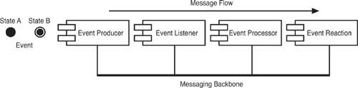
Like our “enterprise nervous system” that we discussed in the Introduction, the EDA works as a whole, taking in signal inputs in the form of event data, processing it, and reacting to it based on some kind of intelligent model. Like the nerve endings that tell us when we are hot or cold, being touched, or falling through the air, event listeners in the EDA quantify information from the world and order it into a form that the EDA can understand. The messaging backbone of the EDA is like the nerve cells themselves, transmitting signals back and forth from various places in the body and toward the brain. The brain is like the EDA’s event processing components. It takes in event data and decides how to respond to it. The event reaction components are like our limbs. Based on the input, we take action, or not.

Slide 45
EDA Then, Now, and in the Future
Older EDAs have typically been event-stream or simple-event oriented and reliant on explicit or nearly explicit designs. Complex event processing, married with implicit capabilities, is really what most people mean when they talk about modern or futuristic EDAs. When you hear someone talk about how, for example, the Department of Homeland Security should be able to instantly know that John Smith, who has bought a one-way ticket for cash, has a fingerprint that matches that of a known criminal based on records kept in Scotland Yard—we are talking about an implicit CEP EDA.
This last example highlights why people are so interested in EDA. The paradigm has the potential to serve many business and organizational needs that are now unmet with existing enterprise architecture. The pressure to build EDAs comes from a desire to bring together information from disparate and unpredictable sources and process it in intelligent ways—even if the information is not in digital form at its creation. In business, the desired result might be agility, or improved profitability. In government, the goal might be tighter security or improved knowledge of the economy.

Slide 46
THE (NOT SO SMOOTH) PATH TO EDA
Taking a huge step back to gain perspective, let’s identify the one architectural feature that you need to have an EDA. That feature is interoperability. Interoperability—the sum total of software and hardware that enables applications, systems, machines, and networks to connect with one another and communicate productively—is either an inhibitor or enabler of EDA. Without simple, cost-effective interoperability, there simply cannot be any EDA. Or, at least, there cannot be the kind of dynamic, implicit, complex EDA that we want now and in the future.

Slide 47
Figure 1.2 The original architecture of a phone company, which consisted of three separate sets of systems for order management, line management, and billing.

Slide 48
In the enterprise architecture shown in Figure 1.2, it made little difference how each group of systems was developed or configured. Each group could run using operating systems, programming languages, or message formats that were completely incompatible with the others. There is nothing inherently wrong with this kind of setup, either. It’s just a nuisance when you want information or procedures from one group to be available with another. That’s interoperation.

Slide 49
DEFINING INTEROPERABILITY
We say we want interoperability. Okay, but what is it, exactly? At its essence, interoperability is just what its name implies. It’s two or more systems performing an operation together. If you and a friend pick up a heavy box together, you are interoperating. Both of your efforts are needed to lift the box. The reason we go over this seemingly obvious explanation is because interoperation in IT is often confused with integration.
For many of us, there is no distinction between interoperation and integration. The two concepts are often linked, and deeply related. However, we like to differentiate between the two because understanding how EDA components such as event listeners and event processors work together becomes easier when the two ideas are treated separately.

Slide 50
Interoperation means making two or more systems communicate or exchange information together, whether or not the systems are connected by any dedicated integration interfaces. In contrast, integration is a scenario where two or more systems are linked by a software interface that bridges the two systems. Integration is the technically specific means of getting two applications to connect, whereas interoperation is the broader scope view of the entire situation. To relate it to a real-world parallel, think about the difference between driving a car and taking a vacation. Of course, you might drive a car to take your vacation. Yet, there is far more to the trip than just sticking the key into the ignition and turning the steering wheel. To go on vacation, you need to know where you are going, why you want to go there, how to get there, and so on. In enterprise architecture, interoperation is the complete set of business and technology factors that make two applications come together. Integration is the conventional, but not exclusive means to that end. In essence, integration can be thought of as “interoperability by any means necessary.”

Slide 51
Figure 1.3 shows a basic point-to-point interoperation scenario at the phone company. For reasons that we explore in the next section, the company finds it necessary to make the order management, line management, and billing systems work together to accomplish specific business functions. There already was one point-to-point interface between the line management and billing systems, but the company wants more connections to serve more business needs. The specific ways that the interoperation is achieved might involve application-to-application connections, network connections, physical connections, user interfaces, database updating, and so on.

Slide 53
DRIVERS OF INTEROPERABILITY
Having a discussion about interoperability issues in IT can often feel like walking in on a movie halfway through. You kind of understand why Mel Gibson is slapping the perp around, but you missed the part where he took the bribe.... In all of our nerdy ruminations about architecture, we often forget a core truth: IT systems and solutions we develop for interoperability all serve some kind of business objective. “Of course,” you say. “That’s obvious.” Yes, it is, but interoperation can get so complex that it becomes its own topic, evolving in its own separate domain.
Although there are myriad reasons why IT needs to get systems to interoperate, we find that there are two essential groups of business requirements that drive the need for interoperability. Business functional requirements are a major driver of interoperation between systems. Business functional requirements are business situations that demand that two or more systems or applications work together to achieve a business objective. In the phone company example, a goal of providing real-time access to any customer account activity, whether it is related to a new order, a billing problem, or a service problem, necessitates interoperation between multiple separate and incompatible systems.

Slide 54
The second driver of interoperation is what we call business extension. Business extension is a situation where management wants to take advantage of data or system functionality to increase the scope of services offered or drive sales growth. For example, the phone company in our example might want to conduct telemarketing of cell phone plans to its landline customers. To attain an optimal marketing result on an ongoing basis, it would make sense for the telemarketers to be able to update the landline account holders’ records with their marketing activities. Assuming the telemarketers were using the order management system as their basis of interacting with customers, the requirement to have the telemarketers update landline customer records—who was called, whether they wanted cell service, and so forth—could result in a requirement for interoperation between the order management and line management systems.
Classic solutions to these requirements are in the form of an abstraction layer—either product-based or custom—that pulls information from (and populates) a shared data store. These solutions are typically specific to a given business function and might not provide the generic interoperability required for long-term agility in an enterprise or product environment.

Slide 55
APPLICATION INTEGRATION: A MEANS TO INTEROPERATE
There is no law of nature that commands us to integrate systems that need to interoperate. We could always rebuild everything and achieve interoperation by smashing separate systems into one, new, unified system. Although that is sometimes the best path to take, it is usually not the one we choose because it is too costly and time consuming. Thus, short of unifying the systems through a significant rebuild effort, some forward-thinking IT organizations defined enterprise integration strategies to allow applications and systems to share data and functionality to better meet the needs of the business community. Historically, such strategies were built around vendor-based enterprise application integration (EAI) suites, also known as middleware. Figure 1.4 shows a basic middleware component that connects the order management, line management, and billing systems in our phone company example.

Slide 56
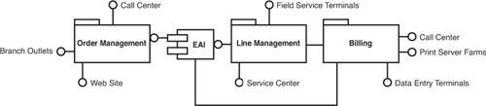

Slide 57
Middleware introduced an isolation tier to buffer the application changes from the integration logic. Typically message-bus based, this form of integration led to the idea of loosely coupled composite systems. The concept was simple, but initially the effort associated with bus-enabling an application proved to be difficult. Developers had to have in-depth knowledge of the target system to build bus connectors, just as they did for case-specific interfaces. Middleware vendors recognized the drawback, and in an effort to promote adoption, built application connectors to give their customers a cheaper alternative to hand-coding connectors. Of course, buying prebuilt connectors meant buying the vendor’s middleware software, and although often cheaper initially than building from scratch, this investment led to long-term business constraints, including limited ability to upgrade or modify applications, insurmountable connector functionality restrictions, and classic vendor lock in. Figure 1.5 shows these adapters and connections in a perhaps more realistic version of what Figure 1.4 presents.

Slide 59
Integrating a middleware suite has typically required deep pockets and willingness to endure significant technical difficulty and organizational fallout. It is unfortunate, but the pain associated with incorporating these middleware suites into an enterprise architecture has prejudiced many technical managers against today’s integration suites, including those based on industry standards (like the Java 2 Enterprise Edition [J2EE] Connector Architecture) and including frameworks that implement common integration design patterns.
To understand how complex and costly EAI can get, look at Figure 1.6, which represents a classic “islands of integration” problem. As is often the case, especially in companies with highly autonomous divisions or postmerger situations, there might be multiple EAI vendors in place in the enterprise architecture. Each EAI suite requires its own adapters to connect to each system. Thus, in the example shown in Figure 1.6, connecting the order management system to the line management system requires the use of an adapter from Vendor B, while connecting that same system to the billing system requires one from Vendor A. License and maintenance fees can add up quickly in this scenario, but the biggest cause of trouble is usually the personnel required to keep it all going and scheduling lags caused by multiple layers of integration and testing.

Slide 60
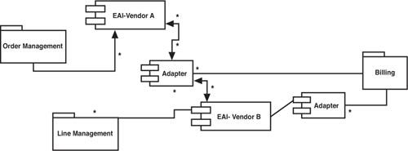
The kind of situation shown in Figure 1.6 is quite common, and it is generally referred to as a tightly coupled architecture. The applications are bound with one another tightly, and making changes can be costly and time consuming. As a result, the expensive and painful lesson learned by many technical managers and architects is that banking an enterprise integration strategy on a proprietary vendor

Slide 61
INTEROPERATION AND BUSINESS PROCESS MANAGEMENT
As integration strategies evolved to include process integration, middleware vendor software suites began to include business process management (BPM) or workflow-oriented integration. Promoting the idea that integration is driven by the business processes, these packages provided a better way to think about combining system functionality. However, as the sophistication of each integration approach increased, the complexity introduced also increased. The increased complexity required more implementation time and resources with a high skill level.
As Figure 1.7 shows, it is possible with certain EAI suites to map business process steps to the specific IT system that supports that step. The process shown in the figure is deliberately blank—we have shown it to get across the general concept. If it helps, you could imagine the process describes how to open a cell phone account as an add-on to a landline account, for example. The process touches each of the company’s major systems

Slide 63
Business process modeling tools and technologies are helpful because they enable businesspeople and IT people to come together with a common communication vehicle that helps lay out specific requirements and solve business issues in ways that are often more streamlined than conventional discovery and requirement iterations. The added complexity that adding BPM to EAI creates, though, can drive cost and delays to an unsustainable pitch.

Slide 64
HOW ARCHITECTURE PROMOTES INTEGRATION
It’s important to understand that interoperability between applications and components is difficult to achieve without overarching, uniform technical direction. With the assessment of our underlying factors in mind, there are some things that your application groups can do now to promote interoperability before your formal strategy is in place. Your application group needs to define coarsely grained, cohesive interfaces (service-based integration). If the predicted evolution includes interaction with other systems, interfaces should be designed to support that direction. Some of these steps in the right direction will become clear to you as you read this book.
Regardless of the interoperability mechanism(s) available to you in your architecture, building your systems with interoperability in mind from the start is the easiest way to achieve long-term system integration. Of course, few of us have the luxury of starting with a blank slate because most enterprises rely on proprietary or homegrown legacy business-critical systems. Unfortunately, interoperability is one of the more difficult things to add to an existing architecture (hence the popularity of middleware solutions).

Slide 65
MANAGEMENT AND GOVERNANCE
Governance is one of those classic words in business—constantly used, constantly misunderstood. The problem is that governance can mean many different things. It can even have multiple definitions for people in the same field. As a result, there can be great confusion about governance. We recommend taking the time to define governance in the context you intend to use it, regardless of how much you think other stakeholders understand it. For your COO, or top IT business partner, governance might have an instant connotation of corporate boards and “governing” the entity known as your corporation. This is the province of bylaws and shareholders, not IT. IT governance, in general, refers to the rules that the corporation sets out to govern the IT function at the business. Your COO might assume you are talking about the organizational structure and accountability of the IT function to the board of directors when you discuss governance with him or her. Alternatively, the COO might think you are talking about Information Security Governance, which typically involves a board-level commitment to securing the information assets of the business. However, in this book, we are concentrating on the “none of the above” governance, which is the way that the business governs the systems it uses to accomplish its business mission. You might need to explain this to the COO so he or she can get where you are coming from. Governance, in the SOA/EDA context, is a body of policies, standards, technological setups, and organizational rules that enable IT systems to make the business run the way it is meant to, while allowing the IT environment to evolve and function optimally.

Slide 66
The term governance is commonly used to define “...the processes and systems by which an organization or society operates.” Information technology governance (or IT governance) is a subset discipline of corporate governance focused on information technology systems and their performance and risk management. Weill and Ross have further refined this definition as follows: “Specifying the decision rights and accountability framework to encourage desirable behavior in the use of IT.”
In contrast, the IT Governance Institute expands the definition to include underpinning mechanisms: “...the leadership and organizational structures and processes that ensure that the organization’s IT sustains and extends the organization’s strategies and objectives.”
Accordingly, SOA Governance can be thought of as
A decision rights and accountability framework
Specifying a set of domain-specific extensions to commonly utilized IT governance methodologies (such as Information Technology Infrastructure Library [ITIL], Control Objectives for Information and Related Technology [COBIT], COSO [from the Committee of Sponsoring Organizations of the Treadway Commission], and so on)
SOA governance is most effective when

Slide 67
The decision rights and accountability framework is combined with the effective operationalization of processes and supporting systems.
It is required to encourage the desirable behavior of participating constituents in the use of IT-enabled capabilities in a service-oriented enterprise environment.
In short, we can describe SOA governance as
The models and structures we use to create balance between constituent needs typically satisfied by an SOA CoE (Center-of-Excellence)
The mechanisms utilized to achieve visibility and coordination typically satisfied by an Integrated SOA Governance Automation solution
The key decisions we make, record, and (in some cases) digitally execute in support of the guiding principles for an IT organization in the form of plan-time, design-time, change-time, and run-time policies

Slide 68
Additionally, SOA governance systems would be expected to support the end-to-end life cycle of an SOA—including planning, analysis, design, construction, change, and retirement of services—combined with the requisite mechanisms (processes, systems, and infrastructure) that support the definition, negotiation, mediation, validation, administration, enforcement, control, observation, auditing, optimization, and evolution of policies and service contracts in an SOA environment.

